Slide 1
AuDitors
Presenter: Anita Tsai
Website: SPOT: https://from.so/
Research Website for University of Michigan (School of Information and Computer Science)
Notes:
anita

Slide 2
Introduction

Slide 3
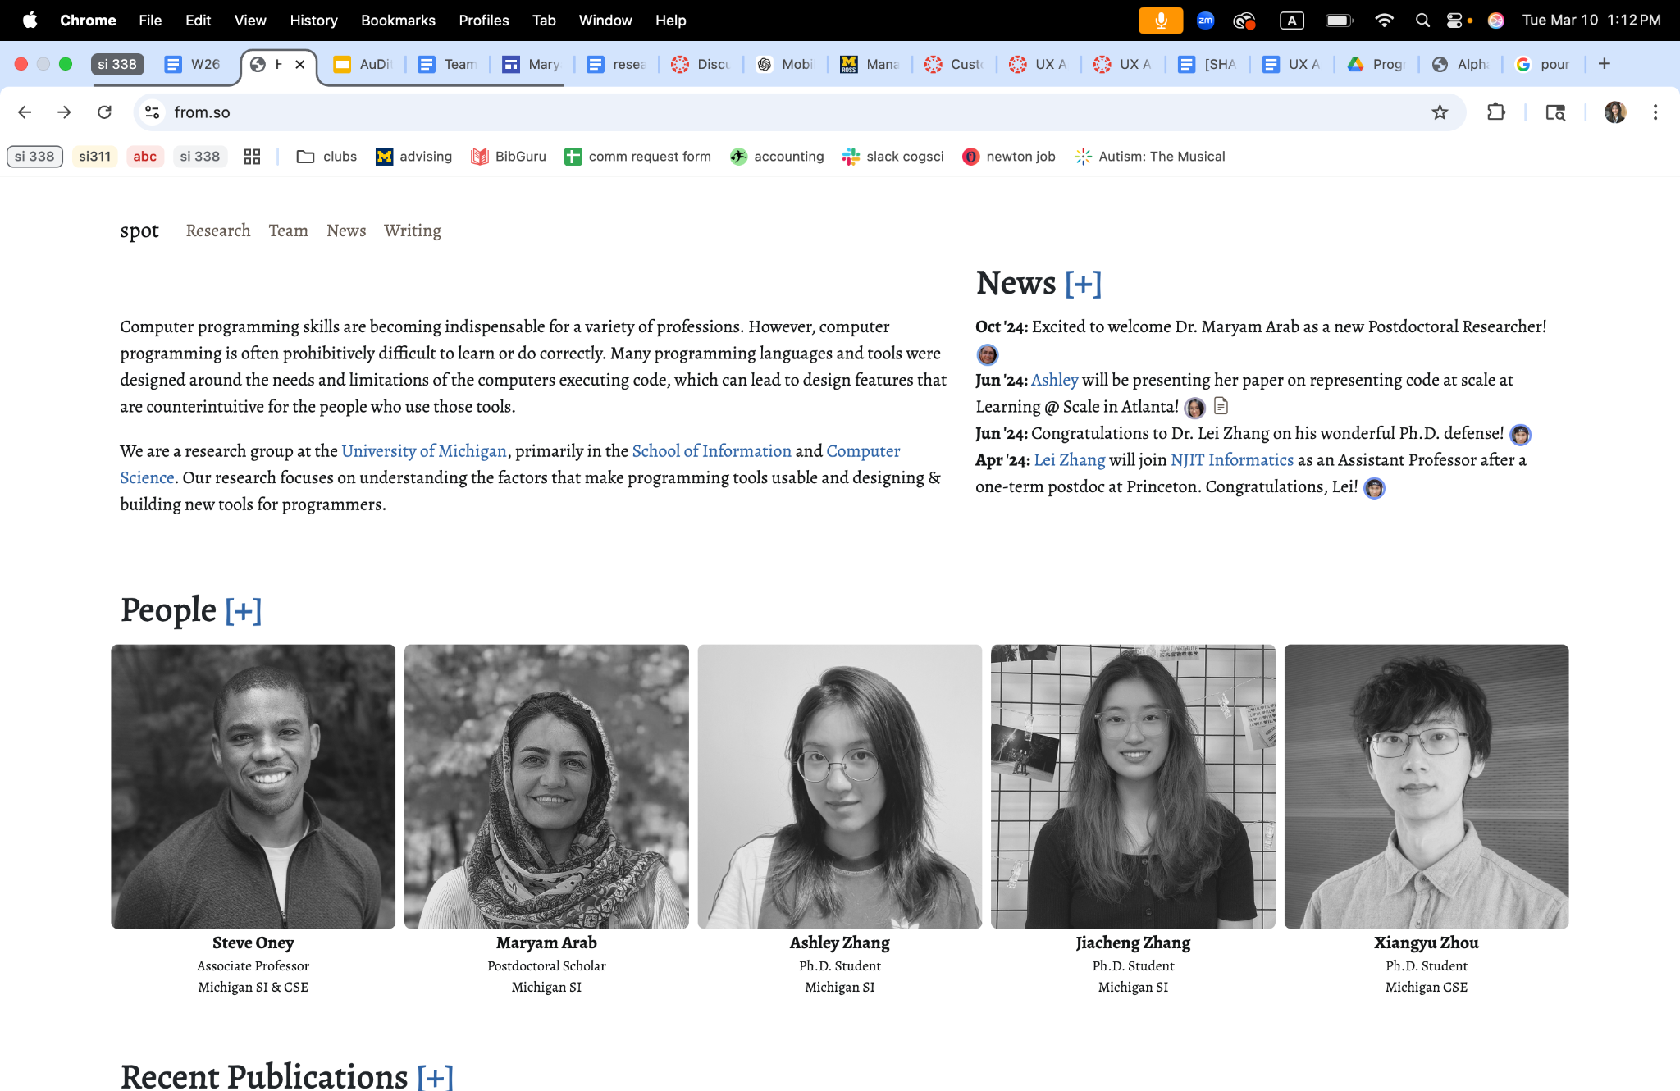
Research site for UMSl + UM CSE
Research focuses on factors that make programming tools usable and designing & building new tools for programmers.

Slide 4
Why we should care about accessibility

Slide 5
1.3 Billion
People or 16% of the world’s population, or 1 in 6 of US population experiences significant disability.
Source: World Health Organization

Slide 6
Users of SPOT
Students
Faculty
Researchers
Collaborators
industry partners

Slide 7
Prospective Students
some students may not be able to navigate application information
they may miss opportunities because they cannot access key content (due to structure)

Slide 8
Students
students with visual impairments may not be able to read publications
students who rely on screen readers cannot interpret images or diagrams without “good” alt text

Slide 9
Faculty /
Researchers
Faculty and research collaborators: explore datasets/access papers:
key information may be difficult to find or interpret
poor structure can make complex research content harder to navigate

Slide 10
100%
Universities should be all inclusive environments

Slide 11
Scope

Slide 12
Tools
Tools used:
WAVE (Chrome Extension)
aXe (Chrome Extension)

Slide 13
Pages
Pages Tested:
Homepage
Research page
Team
News
Maryam Arab
Why?
They represented the most popular pages or pages with examples of complex content

Slide 14
Manual Audit
Reviewed all pages using keyboard navigation to ensure equal access to users
Reviewed all pages at 200% magnification to identify issues for low vision users
Checked color contrast for text on top of images for users with color blindness & low vision
Checked for actionable link text on pages

Slide 15
What We Found

Slide 16
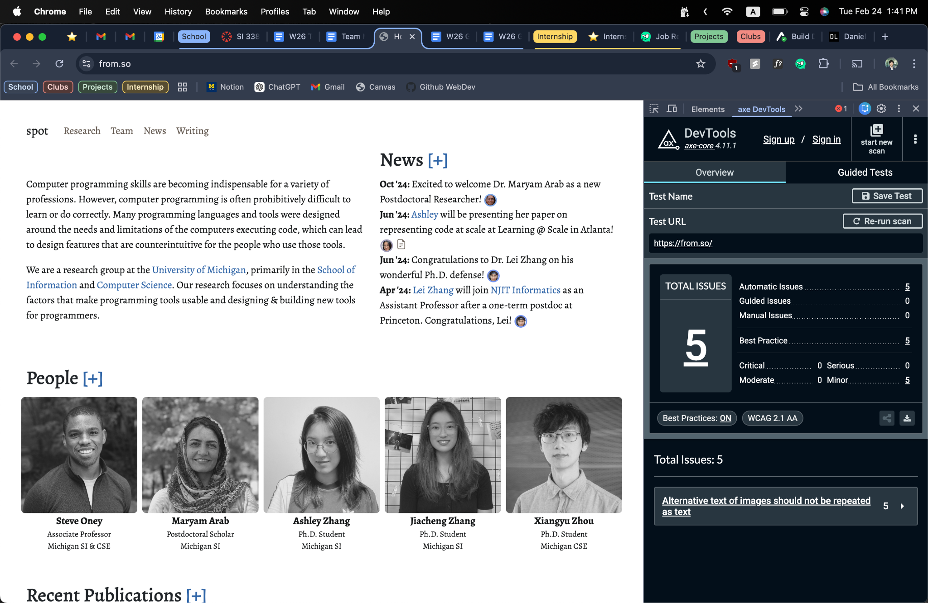
Automated Test Result
Errors:
5 aXe errors:
Alt text shouldn’t be the same as text
Sol: change the caption/text or alt text depending on which is more substantive
Color blind people: can’t see when you hover over
Sol: enlarge or add borderlines when hovered over

Slide 17
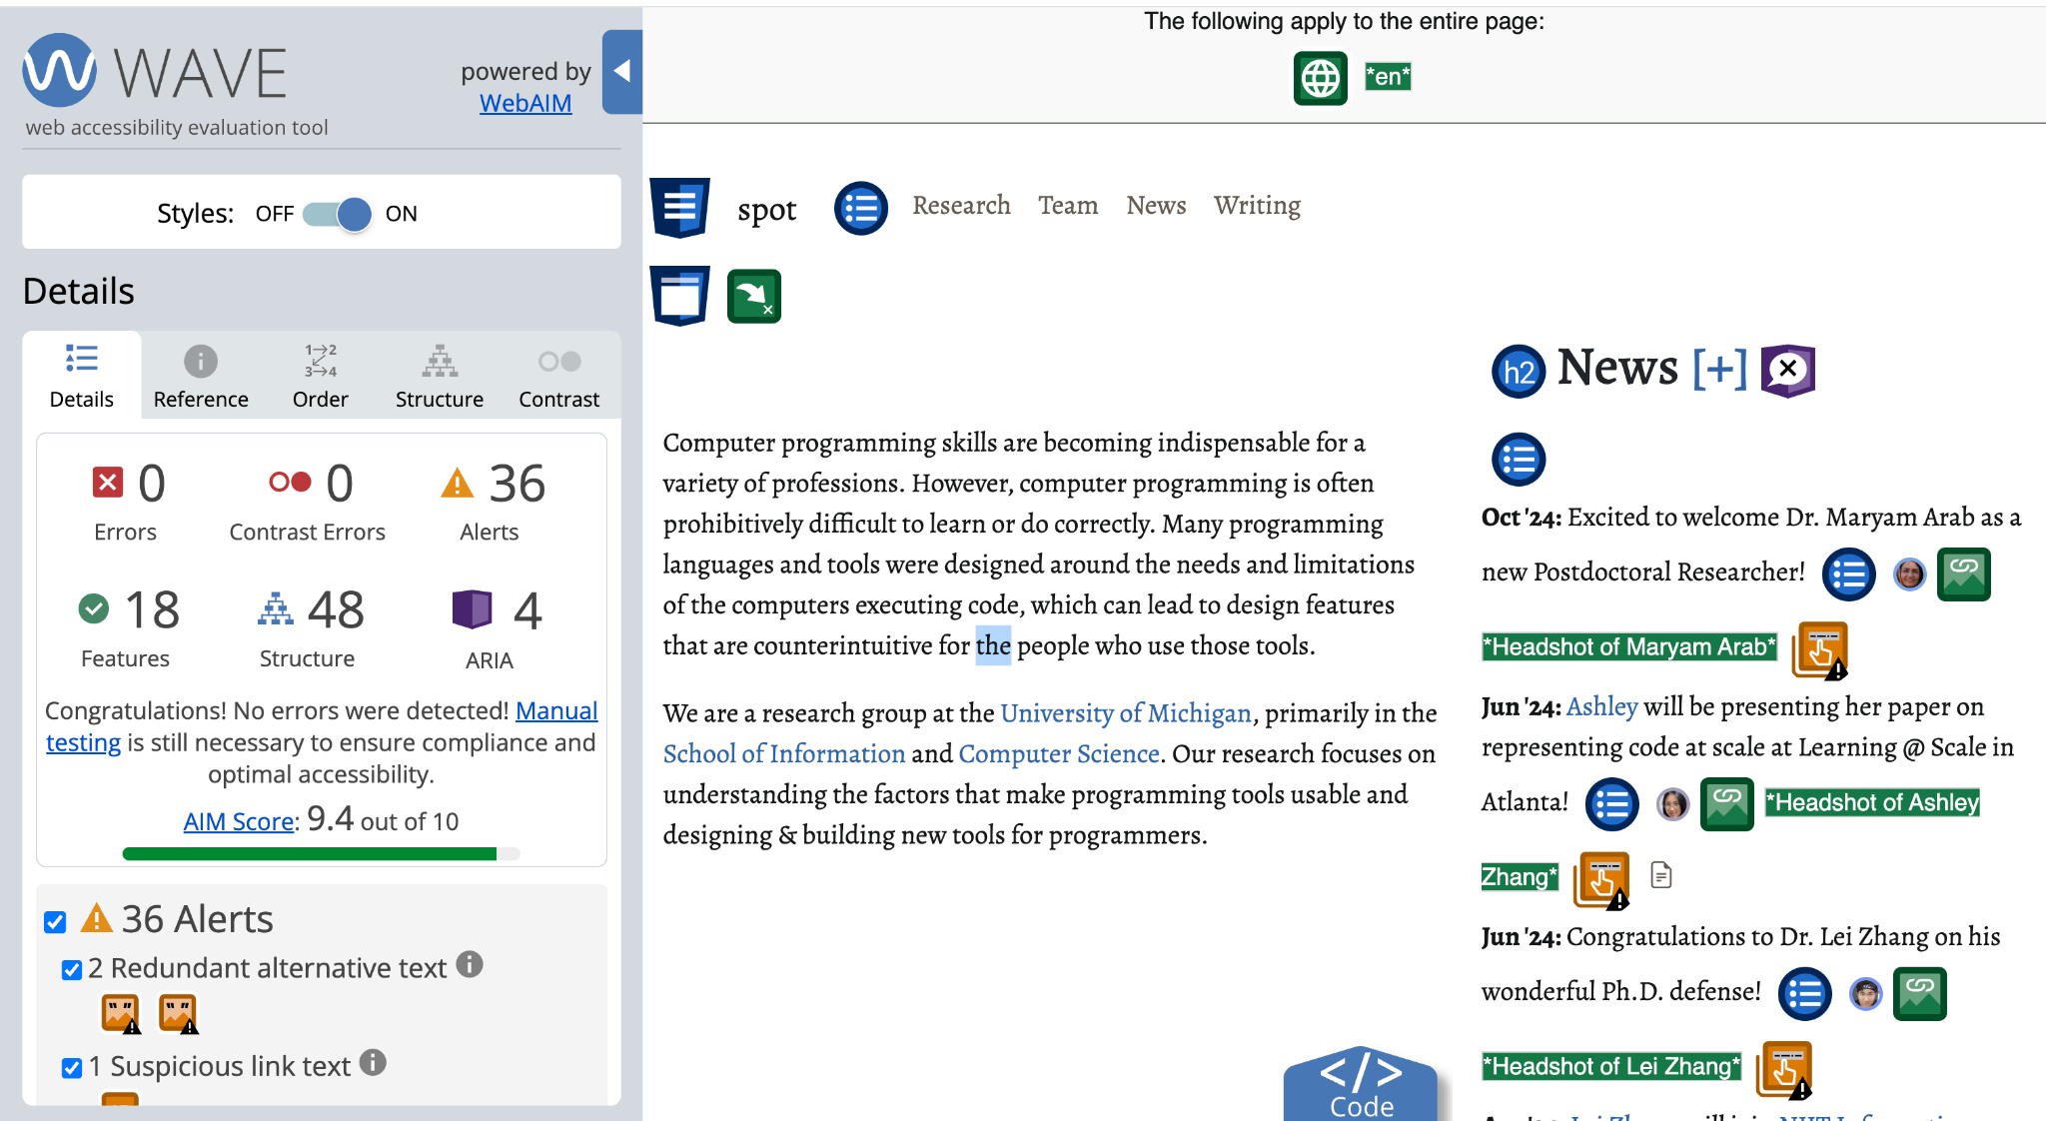
Automated Test Result
Errors:
0 WAVE errors

Slide 18
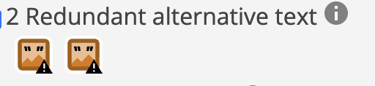
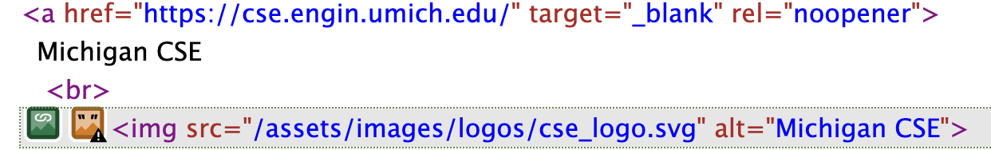
Issue: Alt Text
Problem: All the images have alt texts, but alternative text for an image is the same as nearby or adjacent text.
Why This Is a Problem: Alternative text that is the same as nearby or adjacent text will be presented multiple times to screen readers or when images are unavailable.
Suggested Improvement: Change either the alternative text or the adjacent text to eliminate the redundancy.

Slide 19
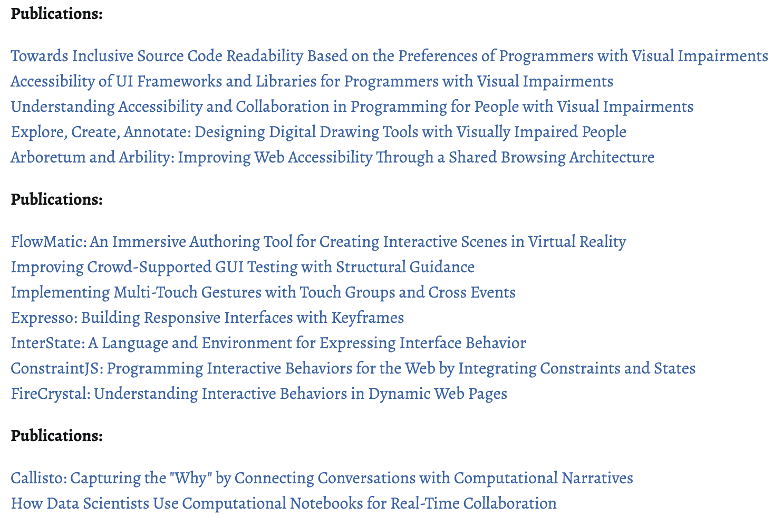
Issue: Publications Page Formatting (Large block of text + acronyms)
Problem: The publications section appears as a long block of text instead of a list.
Why This Is a Problem: A long block of text is harder to read, and might be difficult to access for users with dyslexia or ADHD.
Suggested Improvement: Format publications using lists.

Slide 20
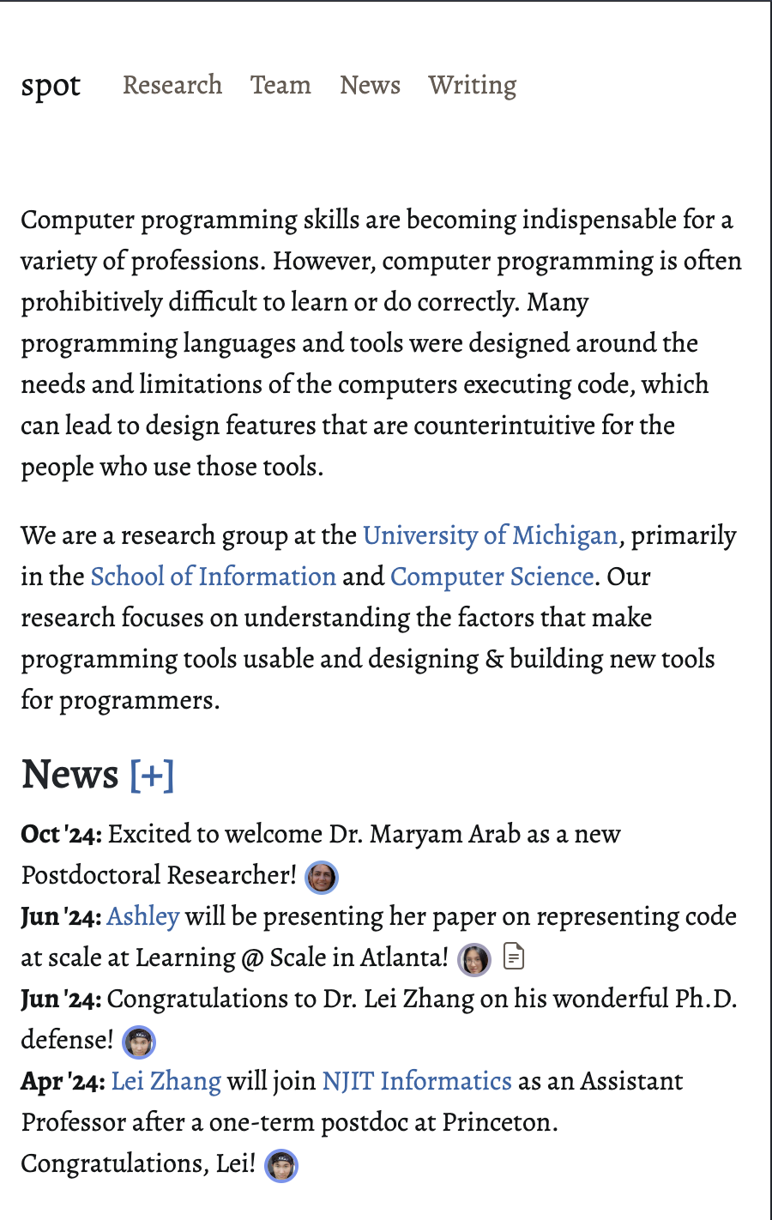
Issue: Mobile Layout Issues
Problem: On mobile devices, the page becomes difficult to read and navigate.
Why This Is a Problem: The page is very text heavy, and when zoomed in, content only appears on the left side.
Suggested Improvement: Adjust layout for mobile screens, so that content uses the full width of the screen.

Slide 21
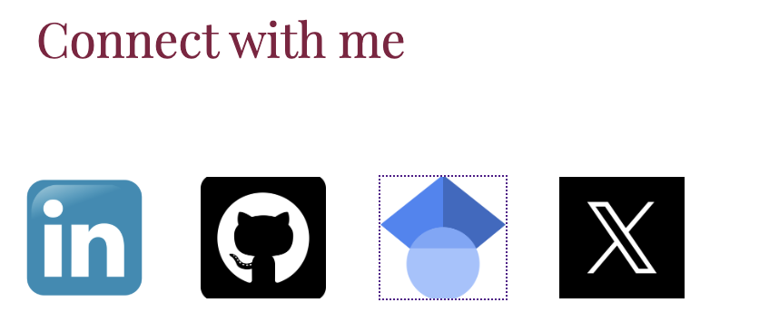
Issue: Icon use on website
Problem: Icons are used on the website.
Why This Is a Problem: Icons can be problematic for accessibility, because their meaning may not be clear to all users and they may not be properly interpreted by assistive technologies such as screen readers.
Suggested Improvement: Provide text labels or accessible descriptions so users can clearly understand the meaning and function of the icons.

Slide 22
Thank You!

